Slide 1
CrowdFunding Project Presentation
Group- 6
Jitendra B Ojha
Pavan Kumar Reddy Devidi
Shiwani Nagare
Santosh Chandure
Monalisa Mallick
N Rahul Reddy
Sunil Shiva Rathod

Slide 2
Objectives
DATA CLEANING AND VALIDATION
REVIEW PERFORMANCE METRICS
IDENTIFY TRENDS AND ANOMALIES
DASHBOARD CREATION (EXCEL)

Slide 3
Project Objective
This project aims to analyze the key factors that drive crowdfunding campaign success and understand performance across categories, locations, and time. This project provides exposure to data cleaning and validation, data importing to different visualization platforms, and analysing the dataset to find out the KPI’s. It focuses on uncovering insights to support crowdfunding operations and designing interactive dashboards and reports to highlight metrics and findings.

Slide 4
Data Transformation & Modelling:
Conversion of epoch dates to natural time.
Building a comprehensive calendar table to facilitate time-based analysis.
Currency conversion of goal amounts to USD.
Date range spanning from the minimum to maximum project creation dates.
Columns created: Year, Month number, Month full name, Quarter, Year-Month, Weekday, Financial Month, and Financial Quarter.

Slide 5
DATA CLEANING
Removing Duplicate Entries
Handling Missing Values
Deleted empty rows
Text Formatting and Standardization
Data Type Corrections

Slide 6
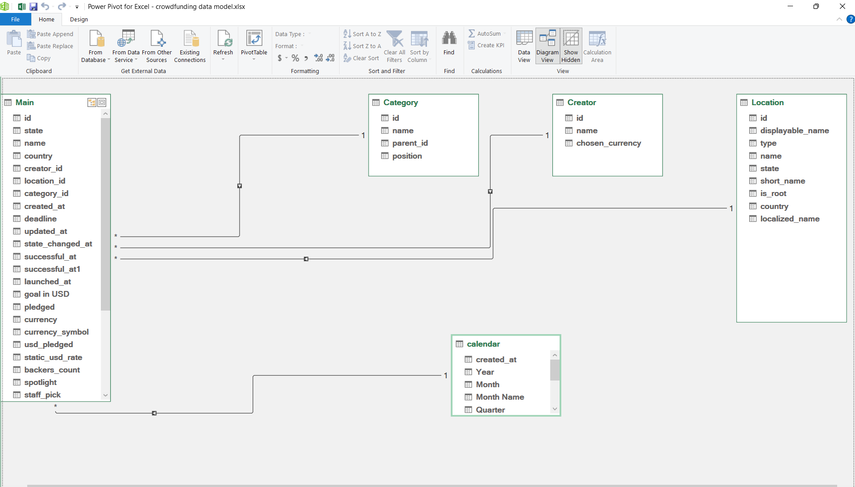
Data Modelling(Relationships)

Slide 7
KPIs and metrics Tracked using the Data Source:
Total number of projects by outcome (successful, failed, etc.)
Breakdown of projects by location and category.
Yearly, quarterly, and monthly project creation trends.
Amount raised for successful projects.
Number of backers for successful projects.
Average number of days to achieve success.
Top successful projects by the number of backers and by the amount raised.
Overall percentage of successful projects.
Success rates by category, year, month, and goal ranges.

Slide 8
DAX
Total Amount Raised by Successful Project
CALCULATE(SUM(Main[goal in USD]),Main[state]="successful")
Avg. No. of Days for Successful Project
CALCULATE(AVERAGE('Calendar'[created_at]-Main[deadline],'Main'[state] = "successful")
Avg_No_of_Days_for_Successful_Project
CALCULATE( AVERAGEX(FILTER('Main', 'Main'[state] = "successful"), 'Main'[deadline] - 'Main'[created_at] ))

Slide 9
THANKYOU

